Slide 1

Log File Management
Kickoff
Oct-2016 / Hugo Pristauz

Slide 2
Contents
Log File Management
Project Team
Motivation
Some Observations
The Proposal
How It Could Look
Implementation Proposal

Slide 3
Project Team
PT: ALDO, BIBR, EMSO, FLSP
SW: BEJA, MARST, FEKO
Vi/Mo: HARI
PJM: HUPR
Project Number: 3000/420123

Slide 4
Motivation

Slide 5
Why Log File Management ?
Answer:
To achieve
efficiency improvements in
system & process engineering!

Slide 6
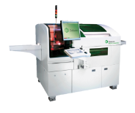

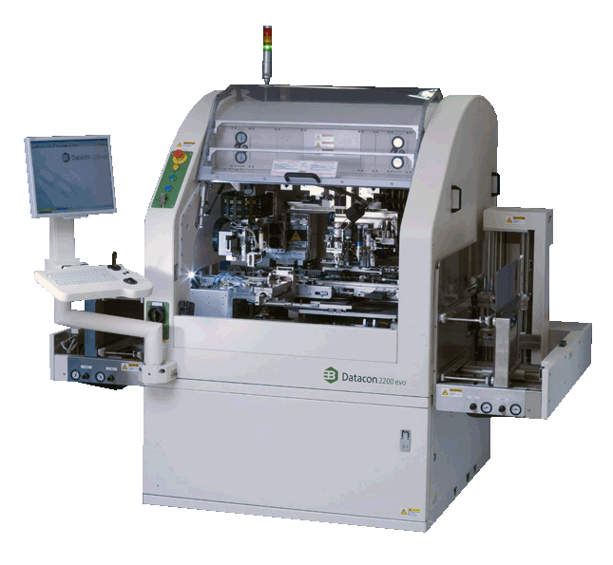

Unification to Improve Efficiency
1) Efficient Diagonsis, Analysis, Debugging
to support efficient analysis/diagnosis/debugging of machine capabilities (e.g., accuracy, temperature, force, TC process, …)
to provide an obligatory SW specification for log file management (every non-compliance is defined as a bug and has to be fixed)
MATLAB is considered as the preferred analysis tool, thus a major goal is to allow log file import into MATLAB with one single universal import (driver) function.
2) Efficient Organization & Information Transfer
to define a unified file organization, which allows efficient transfer (automatic, semi-automatic, manual transfer) of log file packages between machines, personal computers and data bases.

Slide 7
Some Observations

Slide 8
Efficiency Barriers due to Lack of Unification
There are different user /application areas with different requirements
Log data files are generated on machines, stored in data bases and analyzed on personal computers
Lack of unification of log file formats and log file organization is an efficiciency barrier for the work of system & process engineers
R&D tasks
field
serial production
field support
other applications

Slide 9
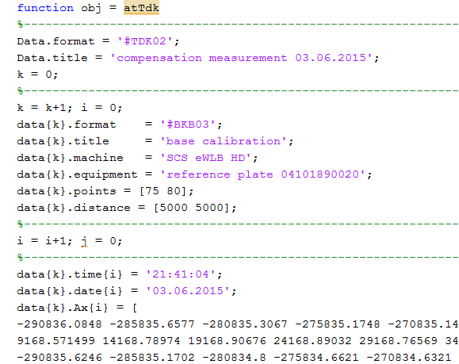
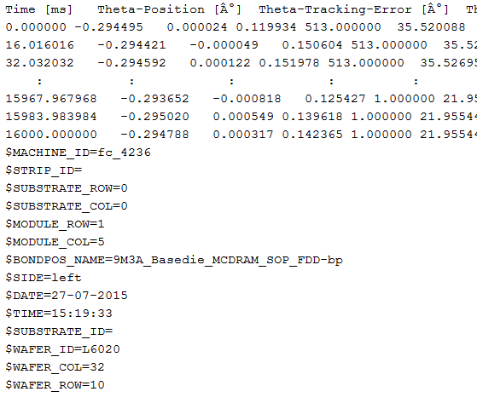
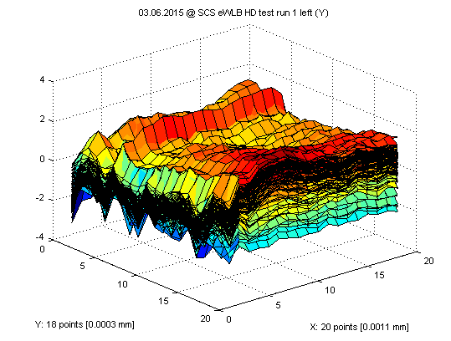
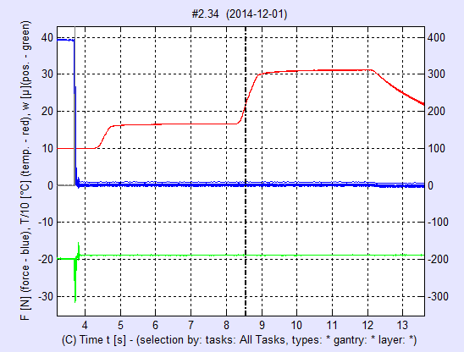
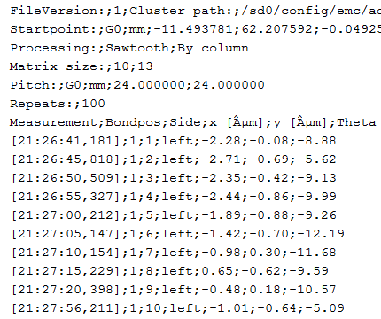
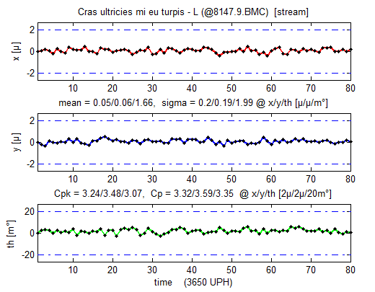
Study of 10 Log File Types
=> VIB, BMC, MBMC, PBI, DANA, TRACE, TPX, DAT, ABC, STAGE

Slide 10
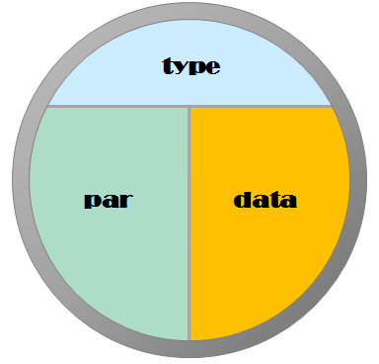
1) Log Data Files Have Structure
a) Structure Elements
type
parameter
data
b) All log data informa-mation follows a syntax
type: dana
type: trace

Slide 11
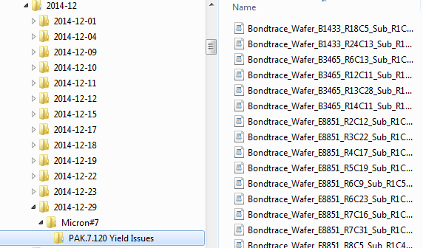


2) Log Data Files Come in Packages
Example 1: TCB Traces
Example 2: Basis Calibration

Slide 12
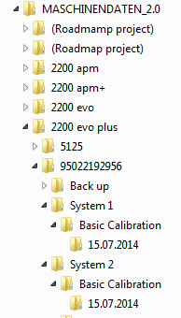
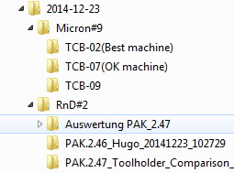
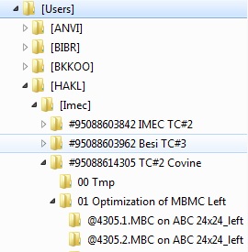
3) Log Data File Organization Provides Context
Example 1: Machine DB
Example 2: TCB Traces
date context
machine context
machine context
machine context
machine context
machine context
m/c type context
type context
machine context
type context
system context
Example 3: Process Engineering
type context
date context
system context
user context
type context
user context
date context
user context
user context
project context
Challenge:
Users should have sufficient freedom to
organize log data files individually
There should be some structure/naming convention
to allow automated context reading
machine context
machine context
machine context
sub structuring
sub structuring
type context
type context

Slide 13
The Proposal

Slide 14
Log File Management
Define & Implement a Log File Management which comprises
Unified Log File Formats
which contain a full set of relevant parameters (needed for efficient analysis)
which can be imported by standardized import (driver) functions
Unified Log Data File Organization
supporting log data packages
contain sufficient information to allow automatic package reading
allows automatic reconstruction of context information
allows project based structuring
Machine Library & GUI Extension
supporting the defined log data file organization
allows project definition and project based organization

Slide 15
Definition & Implementation in Layers
Log File Management Structure
R&D tasks
Core Layer
log file format
file system organization
format
specifics
log file
format
machine
2) Specifics Layer
format specifics
organization specifics
machine LIB & GUI
serial production
field support
lib & GUI
file system
organization
organization
3) Application Layer
R&D tasks
field support
serial production
other applications
specifics
other applications

Slide 16
How It Could Look

Slide 17
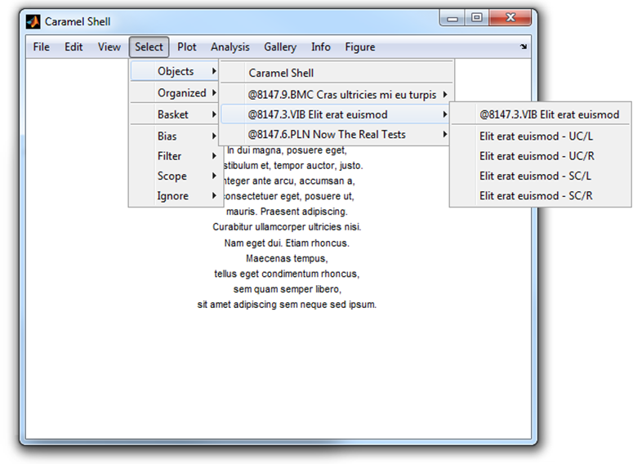
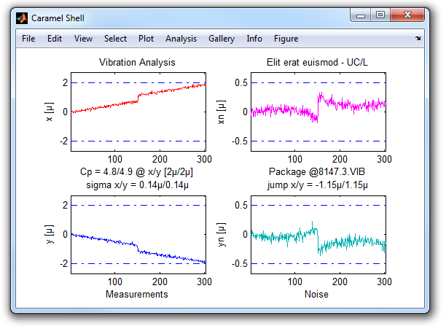
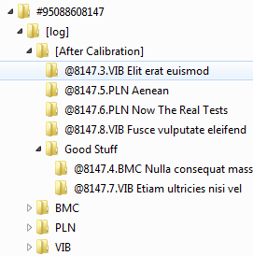
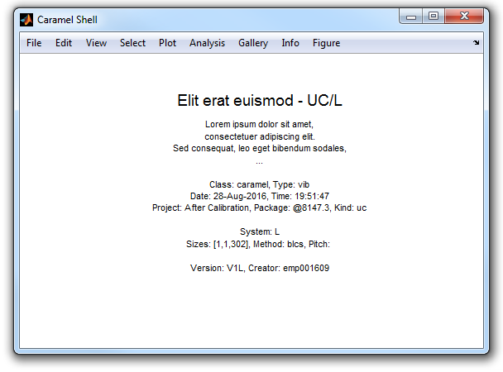
How It Could Look
All log data files are stored in
package folders, each containing
log data of one single type
organization
by package
package info
included in figure
allows easy finding
of package folder
user created a
project ‚After Calibration‘
organization
by package
user decided to
use a sub folder
‚Good Stuff‘ for
better overview
Analysis tools support import of
whole packages without the need of
knowing type/driver details
included key parameters
to allow efficient analysis
and labeling of graphics

Slide 18
Implementation
Proposal

Slide 19
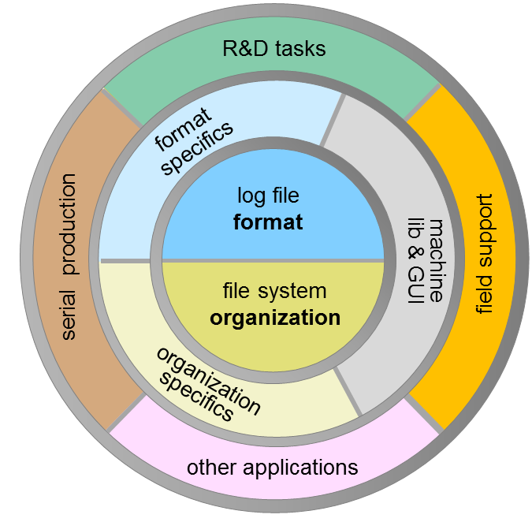
A Huge Project? Tremendous Efforts?
Log file management is concerning a huge field of application areas
R&D tasks
field support
serial production
other application areas
To implement a log file management for all
application areas requires tremendous efforts
tremendous definition and alignment efforts
tremendous implementation efforts
To move forward a step-by-step approach for both definition and implementation is proposed. A layer organization of the log file management system supports a step-by-step approach.

Slide 20
Proposed Step-by-Step Approach
Phase 1
Define a core log file management system comprising core format and core file organization ^{*)}
Setup a log file management key group
Align core definitions with key group
First alpha test
Phase 2
Define log file format specifics with key group
Each new logging has to be implemented according to core format and format specifics
Phase 3
Define file organization with key group
Implement log file management dialogs in machine SW (library)
Each new logging has integrated log file dialogs
Phase 4
Case-by-case backward integration of log file management
Case-by-case implementation of data base functionality
*) already done (HUPR, FLSP, EMSO)

Slide 21
To Be Discussed Further
unified definition of coordinate systems
need of log file data storage at the machine?

Slide 22
Thank You

